Slide 1
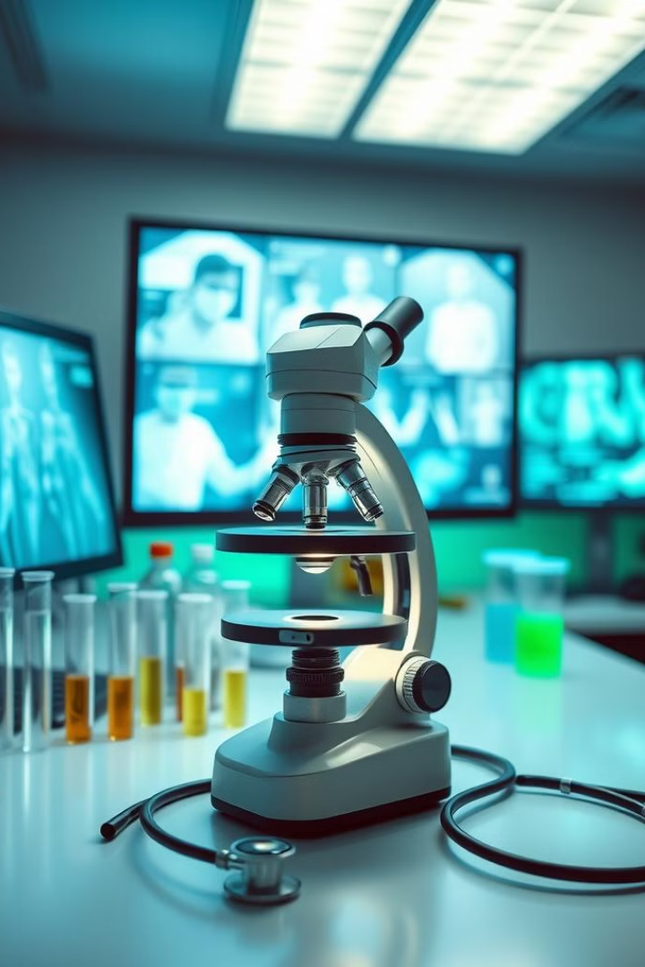
Introduction to Breast Cancer and Medical Diagnosis
In this first milestone, we will dive into the world of breast cancer and the crucial role of early detection. We'll explore the types of breast cancer, the importance of timely diagnosis, and how machine learning is revolutionizing medical diagnostics.

Slide 2
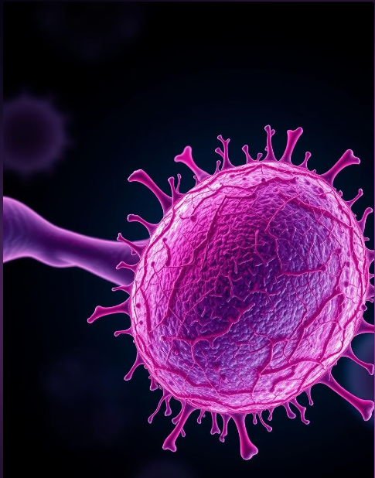
PROBLEM STATEMENT
Breast cancer remains one of the most prevalent cancers worldwide, with early detection being essential for effective treatment and improved survival rates. However, manual diagnosis through traditional methods is time-consuming and may lack precision due to human error.
This project aims to leverage machine learning, specifically the AdaBoost classifier, to develop a reliable and accurate model for distinguishing between benign and malignant breast tumors. By analyzing features from a widely-used breast cancer dataset, the goal is to enhance diagnostic accuracy and support healthcare professionals in making timely, data-driven decisions for patient care.

Slide 3
Breast Cancer and Medical Diagnosis
Understanding Breast Cancer
Early Detection Saves Lives
Diagnostic Techniques
Early detection is crucial as it allows for more effective treatment and increased chances of survival. Regular checkups and screening tests are vital.
Medical professionals utilize various techniques, such as mammograms, biopsies, and imaging scans, to accurately diagnose and stage breast cancer.
Breast cancer is a malignant tumor that originates from breast cells. It can be classified as either benign (non-cancerous) or malignant (cancerous).

Slide 4

Understanding Breast Cancer and the Importance of Early Detection
Breast Cancer Types
Stages of Breast Cancer
Breast cancer can be classified as either ductal carcinoma or lobular carcinoma, based on the origin of the cancer cells.
Breast cancer is staged from 0 to IV, with stage 0 being non-invasive and stage IV being the most advanced.
Importance of Early Detection
Regular Screening
Mammograms, clinical breast exams, and self-examinations are crucial for the early detection of breast cancer.
Early detection allows for more effective treatment options and significantly improves the chances of survival.

Slide 5
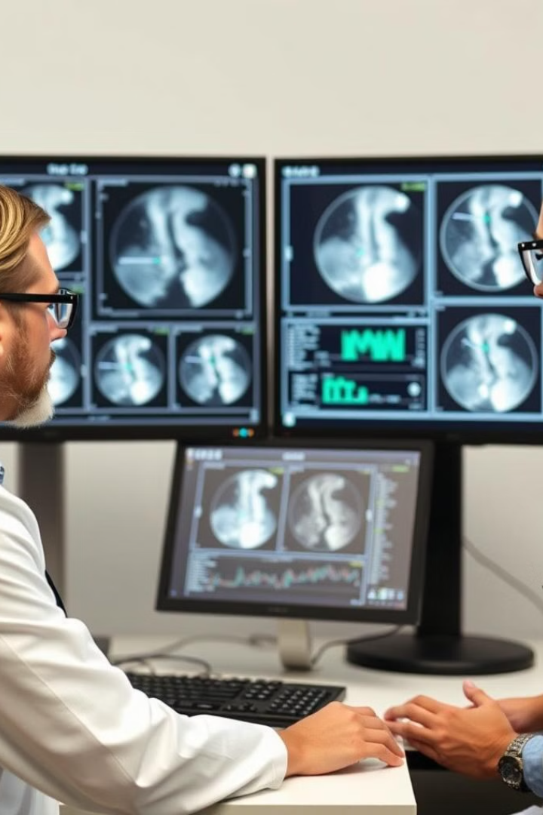




Machine Learning in Healthcare for Early Detection
Data-Driven Insights
Automated Diagnosis
Machine learning algorithms can analyze vast amounts of medical data to identify patterns and anomalies that might indicate breast cancer.
ML-powered systems can assist medical professionals in interpreting diagnostic tests, such as mammograms, with greater accuracy and speed.
Predictive Analytics
Remote Monitoring
Machine learning models can help predict the risk of developing breast cancer, enabling proactive screening and early intervention.
Telemedicine and connected devices powered by ML can facilitate remote monitoring and early detection of breast cancer.

